Slide 1


Infosys_Springboard_Virtual_Internship-2026_Batch-11_Team-A
ElectViz: Election Data Visualization for Media
Transforming Indian Election Data into Actionable Insights
Presented by: Vaibhav Pawar
Mentor: Mrs. Nithyasri S J

Slide 2
INTRODUCTION
Unlocking the Power of Indian Election Data
Indian elections, characterized by their immense scale and diverse voter base, generate an overwhelming amount of data. This raw, unstructured data, while plentiful, often fails to provide clear insights into voting patterns, candidate performance, or underlying electoral trends. ElectViz addresses this challenge by transforming complex datasets into meaningful, digestible visual narratives.
Complex Datasets
Beyond Raw Numbers
Indian elections generate incredibly large and often intricate datasets that are difficult to interpret without proper analysis tools.
Raw data alone cannot adequately explain the nuanced voting patterns, demographic influences, or shifts in political sentiment.
Meaningful Insights
Powered by Power BI
ElectViz converts this complex election data into actionable insights, making it accessible and understandable for a wide audience.
The platform is built using Microsoft Power BI, leveraging its robust capabilities for data integration, transformation, and visualization.

Slide 3

OBJECTIVES
Driving Data-Driven Electoral Analysis
ElectViz is designed to empower journalists, political analysts, and researchers with the tools needed to delve deep into Indian election dynamics. By providing a clear and comprehensive view of historical data, we aim to foster more informed discussions and precise predictions about electoral outcomes.
1
Comprehensive Data Analysis
Analyze extensive Indian State Assembly election data spanning from 2009 to 2021.
2
Identify Key Trends
Pinpoint overarching electoral trends and assess the competitiveness of various constituencies.
3
Evaluate Performance
Conduct in-depth studies on the performance of political parties and individual candidates over time.
4
Support Informed Analysis
Provide a robust foundation for data-driven media narratives and comprehensive political analyses.

Slide 4
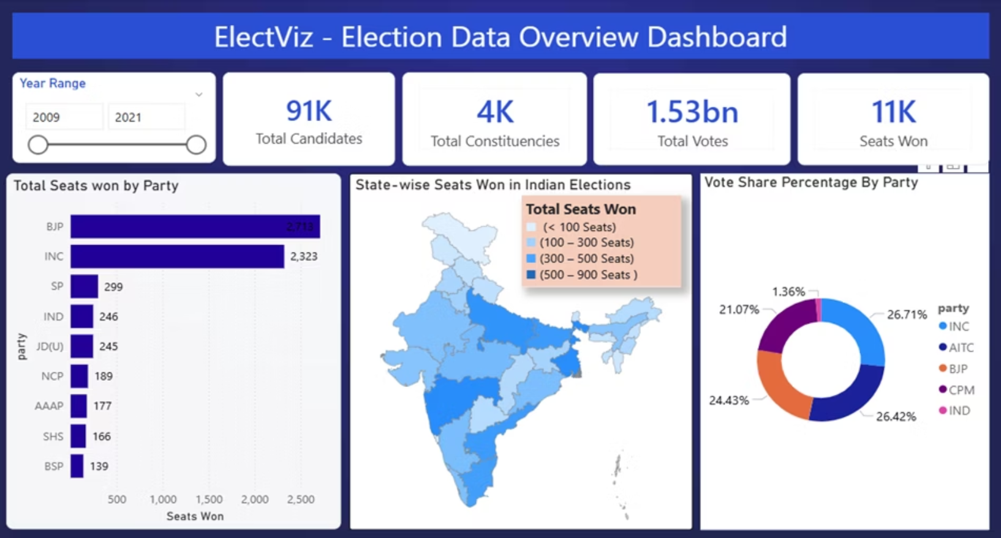
DATASET
A Deep Dive into Electoral Data
Our analysis draws from a rich dataset encompassing Indian State Assembly election results, providing a granular view of electoral activities. This comprehensive collection forms the backbone of ElectViz's analytical capabilities.
Scope: Indian State Assembly election data.
Volume: Over 6,000 individual records, ensuring a broad analytical base.
Structure: Each record contains 11 structured columns of critical electoral information.
Key Variables: Includes data on candidates, political parties, vote counts, victory margins, and relevant demographics.
Source & Preparation: Data meticulously sourced and thoroughly cleaned using Power Query to ensure accuracy and consistency.
The dataset provides a robust foundation for understanding the intricate dynamics of Indian state elections.

Slide 5
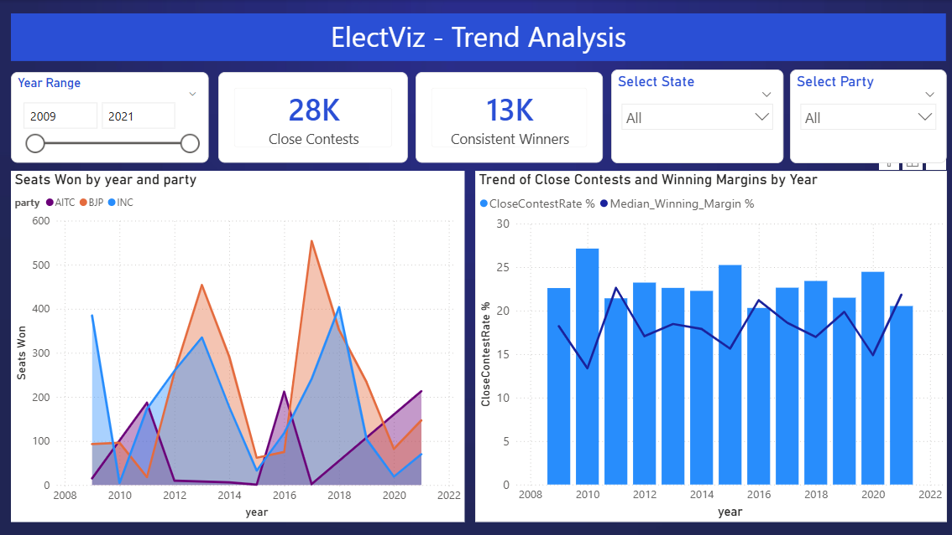
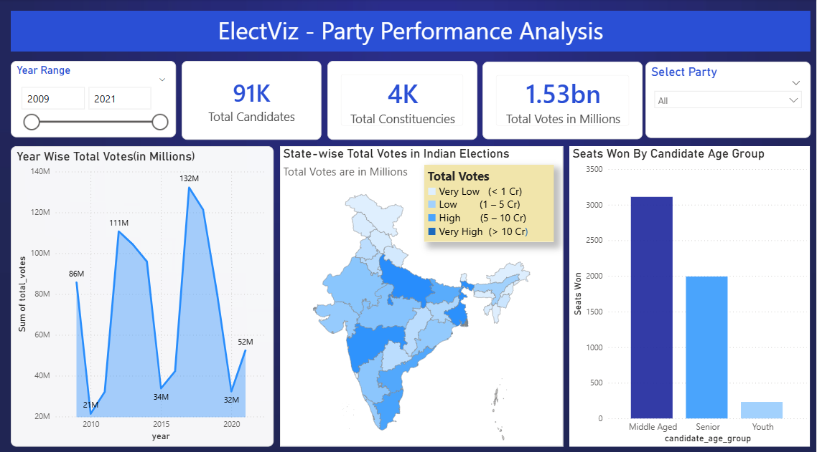
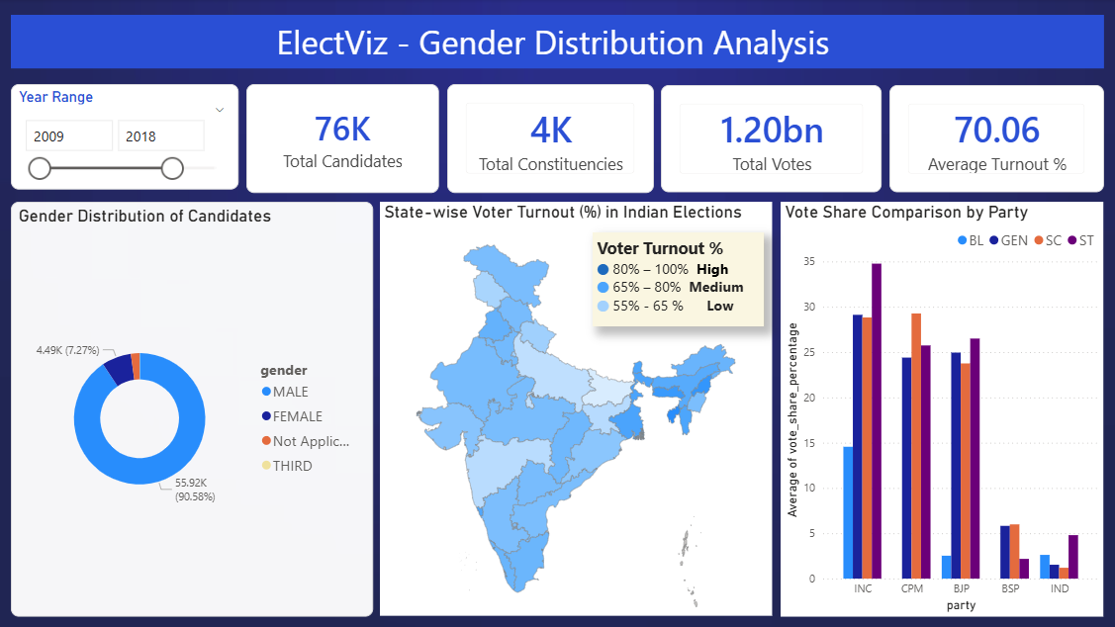
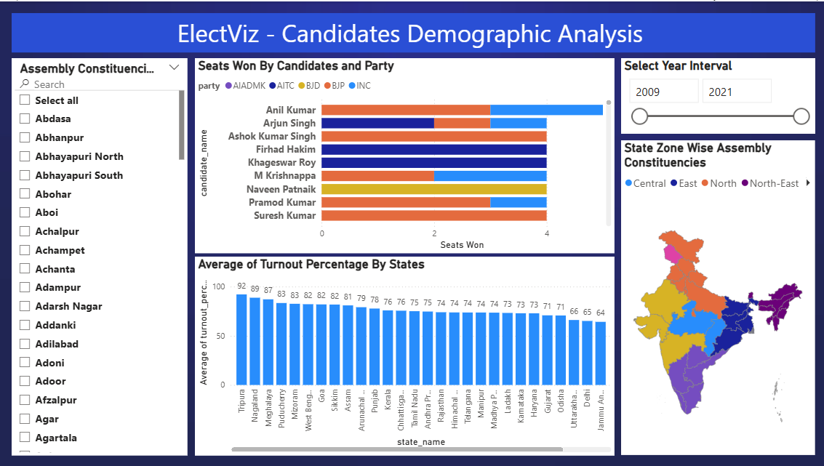
Dashboard Overview:-

Slide 6

System Design :
ElectViz: Our End-to-End Workflow
Data Cleaning
Data Collection
Data Modeling
DAX Measures
Visualization
Validate, cleanse, and transform inputs
Gather raw data from trusted sources
Design relationships and semantic model
Create calculations and business logic
Build interactive Power BI reports
Our meticulous approach ensures high-quality insights derived from reliable data, covering every stage from raw data acquisition to interactive visualization.
1. Data Collection
2. Data Cleaning & Transformation
3. Data Modeling
Sourced from reputable platforms like Kaggle and official election commission archives, ensuring comprehensive coverage.
Implemented a robust Star Schema design to optimize data relationships and enhance query performance.
Utilizing Power Query within Power BI to refine raw data, addressing inconsistencies and preparing it for analysis.
4. DAX Measures & Calculations
5. Visualization using Power BI
Developed sophisticated Data Analysis Expressions (DAX) to create custom metrics and derive deeper insights.
Crafted intuitive and interactive dashboards in Power BI, enabling users to explore and understand the election data visually.

Slide 7
Data Transformation :
Ensuring Accuracy:
The integrity of our analysis hinges on the quality of the underlying data. Our rigorous transformation process ensures that every piece of information is accurate, consistent, and ready for insightful visualization.
Duplicate Removal
Missing Value Handling
Standardized Naming
Systematic identification and elimination of redundant records to prevent skewed analysis.
Strategic imputation or removal of incomplete data points to maintain dataset completeness.
Consistent formatting of party names and other categorical variables for uniformity.
Calculated Fields
Quality & Consistency
Creation of derived metrics like victory margins and candidate age groups to enrich analytical depth.
Continuous validation checks to ensure the highest standards of data quality and consistency throughout the dataset.

Slide 8
Future Enhancements
Roadmap for ElectViz
To further enhance ElectViz's capabilities and provide even deeper insights, we plan to integrate advanced analytical techniques and real-time data processing. These enhancements will ensure the platform remains at the forefront of election data visualization.
01
02
03
Predictive Modeling
Enhanced Demographic Integration
Real-Time Data Updates
Implement advanced statistical models to forecast election outcomes, providing forward-looking insights.
Develop mechanisms for live ingestion and visualization of election data during ongoing processes.
Incorporate more detailed demographic data for a granular understanding of voter behavior and segmentation.
04
05
Constituency-Level Drill-Through
Sentiment Analysis
Enable users to drill down into specific constituency data for highly localized analysis.
Integrate news and social media sentiment analysis to gauge public opinion and its impact on elections.

Slide 9

SUMMARY:
ElectViz: Empowering Electoral Understanding
ElectViz is more than just a tool; it's a testament to the power of data visualization in transforming complex information into accessible narratives. It serves as an invaluable resource for anyone seeking to understand the intricate patterns and dynamics of Indian elections.
Data to Insights
ElectViz excels at converting raw, unwieldy election data into clear, actionable insights.
Broad Utility
Designed to support a diverse audience, including media professionals, academic researchers, and political analysts.
Power of Visualization
Showcases the immense potential of data visualization as a powerful storytelling medium in electoral analysis.
Future-Ready
Built with scalability in mind, ElectViz is designed to adapt and grow with future elections and evolving analytical needs.

Slide 10
ElectViz – Milestone Wise Summary :-
🔹 Milestone 1
(Power Query & Data Preparation Phase)
Focus:
Data cleaning, transformation, and preparation for analysis.
What Was Done:
Imported two election datasets:
State & Constituency-level data
Candidate & Party-level data (6,248 rows)
Used Power Query Editor for:
Removing blank rows and duplicates
Renaming columns
Standardizing party abbreviations
Assigning correct data types
Handling missing values
Sorting and filtering records
Kept only relevant analytical columns.
Outcome:
Clean, structured, and optimized dataset ready for dashboard creation.
Strong foundation for accurate visualization and reporting.
Ensured data consistency and reliability.
🔹 Milestone 2
(Core Dashboard Development Phase)
Focus:
Creating initial dashboards and analytical metrics.
Dashboards Created:
Election Overview
Party Performance Analysis
Gender Distribution Analysis
Key Additions:
Created calculated columns:
Vote Share %
Result Status
Candidate Age Group
State Zone
Developed DAX measures for:
Seats Won
Average Turnout %
Total Votes
Major Insights:
BJP & INC dominate nationally.
Regional parties dominate within specific states.
Middle-aged candidates win most seats.
Female participation remains low (~10%).
Vote share does not always convert into seats (FPTP impact).

Slide 11

🔹 Milestone 3
(Candidate & Electability Analysis Phase)
Focus:
Deep candidate-level and electability analysis.
New Pages Added:
Page 4 – Candidate Demographic Analysis:
Seats won by candidate & party
State-zone mapping
Average turnout by state
Constituency-level filtering
Page 5 – Electability Analysis:
Total Elections KPI
Close Contests KPI
Average Win Rate %
Vote Share vs Win Rate comparison
Key Insights:
High vote share ≠ High win rate.
Some parties contest more but win less.
Close contests are very frequent.
Party efficiency matters more than popularity.
🔹 Milestone 4
(Trend & Winning Factor Analysis – Advanced Phase)
Focus:
Trend analysis and outcome-oriented evaluation.
New Pages Added:
Page 6 – Trend Analysis:
Close Contest Rate %
Average & Median Winning Margin
Seats Won by Year & Party
Consistent Winners
Page 7 – Election Outcome & Winning Factors:
Repeat Candidate Rate %
Top 10 Parties by Winning Margin
Scatter Plot: Seats Won vs Winning Margin
Major Findings:
Elections are becoming more competitive.
Close contest rate is increasing.
Median margin is better than average for competitiveness.
High winning margin does not guarantee more seats.
Efficient close wins lead to higher seat counts.
Repeat candidates have higher success probability.

Slide 12
ElectViz – Milestone Summary
ElectViz is an interactive Power BI dashboard designed to transform complex Indian election data into clear, meaningful, and actionable insights.
The project analyzes over 6,000+ election records (2009–2021) using structured data modeling, Power Query transformation, and DAX measures to evaluate:
Party performance trends
Candidate demographics (age & gender)
Electoral competitiveness
Winning margins & repeat candidate success
Vote share vs seat share relationship
The dashboard enables users to filter data by year, state, and party, allowing dynamic exploration of electoral patterns.
Vote share does not always convert into seat share (FPTP impact).
Middle-aged candidates show higher electability.
Female political participation remains significantly low.
Elections are becoming increasingly competitive with lower winning margins.
ElectViz demonstrates how data visualization enhances political analysis and storytelling. It provides a scalable, interactive, and research-oriented solution for media professionals, analysts, and policymakers.
🔎 Key Findings:
🎯 Conclusion:

Slide 13
Acknowledgement & References:-
We would like to express our heartfelt gratitude to : Infosys Springboard Team – for organizing this valuable internship opportunity.
Our Mentor – for her continuous support and feedback. My Teammates – for collaboration, encouragement, and insights
This internship has been a significant step in our professional growth and technical journey.
Election Dataset (Election Commission of India / Kaggle source)
Microsoft Power BI Documentation
Infosys Springboard Virtual Internship course materials
Acknowledgement:
References:

Slide 14
Thank you

